Slide 1

WHY ARMY PHYSICAL TRAINING SHOULD BE INDIVIDUALIZED
ARMY PT AND STANDERDS

Slide 2



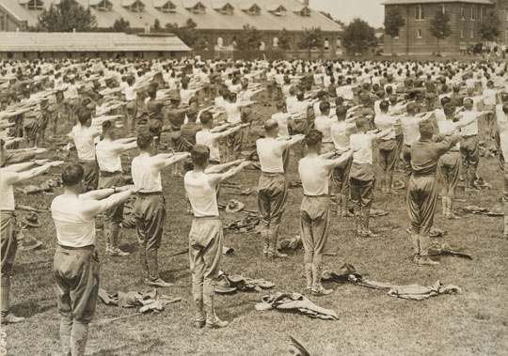
ARMY PT HISTORY
WWI brought about formalized PT and training around 1916 as the need for soldiers on the frontline decreased.
Basic Training became more structured to train and refine soldiers.
Drill and Ceramony were taken very seriously during this time and were a vital part of a soldier’s daily routine.
WWI highlighted the dangers of war for unfit and untrained Soldiers.

Slide 3
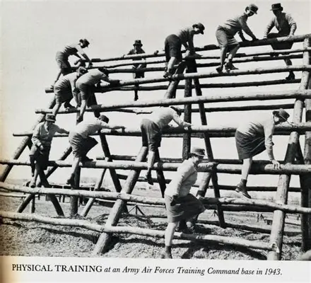
ARMY PT HISTORY
First PT test in the army was developed in 1946 during WWII.
Test consisted of squat jumps, sit-ups, pull-ups, and a 300- yard run.
Emphasis on strength and endurance.
Marching, lifting, combat drills, and obstacle courses also began to be incorporated into training.

Slide 4
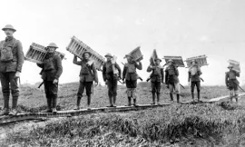
ARMY PT HISTORY
After World War II, PT standards declined and Soldier readiness suffered, leading to poor performance during the Korean War.
In hindsight, it was confirmed that many casualties in this and previous wars were due to inadequate physical readiness. As a result, FM 21-20 was introduced in 1959, establishing Army Physical Readiness Training (PRT).

Slide 5
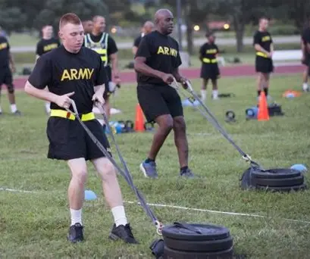
ARMY PT HISTORY
The development of PRT was pivotal for how the Army’s physical training standards are set up today.
This started the process of refining the PT test which got changed many times and was just changed again in 2025.
PRT led to the tradition of daily group PT which has looked different over the years but has always started around 0630.

Slide 6
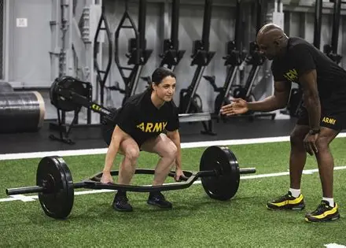
ARMY PT TODAY
Morning PT is heavily encouraged with the use of APEX.
Apex is an online application that tells what each morning workout will be.
Apex consists of CrossFit type exercises that target muscular and aerobic endurance.

Slide 7
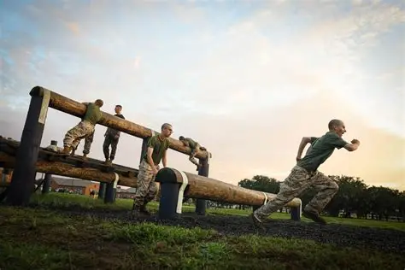
ARMY PT TODAY
The use of obstacle courses and combat related exercises are almost obsolete for any MOS that isn’t combat related.
Occasionally, Soldiers participate in combat-related training during competitions or special training events.

Slide 8
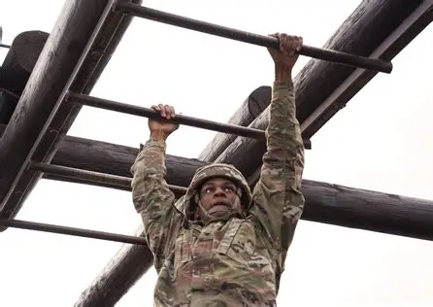
ARMY PT TODAY
New standards have been developed for the fitness test in 2025.
In recent years it was the ACFT ( Army Combat Fitness Test) which is now called the AFT (Army Fitness Test).
The standards for the semi-annual test have changed slightly and one exercise has been removed.

Slide 9
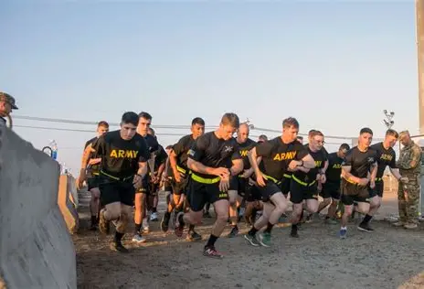
ARMY PT TODAY
The AFT now consists of five exercises which was previously six.
Deadlift, Push up, Sprint-Drag-Carry, Plank, and a Two-mile run.
The standing power throw was recently taken out due to it’s negative impact on peoples scores.

Slide 10
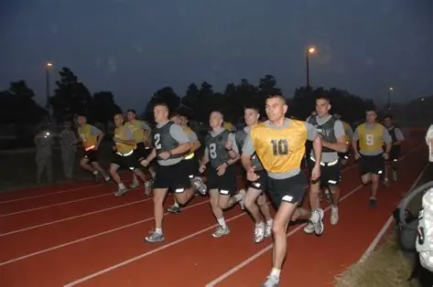
ARMY PT TODAY
Formation runs are used to boost moral and for the higher ups to engage with soldiers.
Cadences are sung and guideons are held.
This is done only on special occasions or when one is at a school or training event.

Slide 11
ISSUES WITH MODERN PT
APEX, the online application developed by civilians, is the main issue many, including myself, have with modern PT in the organization.
For many years, the organized PT that has been done since WWII was the standard, but now everything has changed.
The army has taken away combat related fitness and workouts that are geared towards going to war to make sure people are getting high scores on the semi annual AFT.

Slide 12
ISSUES WITH MODERN PT
One of the Army’s number one priorities is accountability.
Through Apex they can track soldiers even more efficiently than before but unfortunately that leads to a shift in priorities.
Quantity of participation is often valued over the quality of training.

Slide 13
ISSUES WITH MODERN PT
Lack of obstacle courses, rucking, and warrior tasks and battle drills.
Army cares more about good AFT scores than they do about preparing soldiers for future missions.
Support MOS’s are inadequately trained for conflicts.

Slide 14
WHAT PT SHOULD BE
Army PT should fully get rid of APEX.
APEX has damaged organized PT and has taken away soldier's moral.
PT should be decided by NCOs in the organization not civilians.

Slide 15
WHAT PT SHOULD BE
The organization should bring back formation runs, cadences, and group PT.
At the same time, PT should be individualized to address each Soldier’s strengths and weaknesses.
Standards should be stricter for out of shape individuals to weed out unfit candidates.

Slide 16
WHAT PT SHOULD BE
The AFT should be unisex with the same standards for male and female.
Current female standards are significantly lower than male standards, which contradicts the push for equality and equal treatment in the Army.
If individuals cannot meet the highest common standard, they should reconsider their career field.

Slide 17
WHAT PT SHOULD BE
All MOSs should be trained to the same physical standards.
Non-combat roles are often trained poorly due to a perceived lack of physical demands, but this is not a valid excuse.
The standards should be the same across the board.

Slide 18
WHAT PT SHOULD BE
Senior leadership should prioritize overall Soldier readiness instead of focusing solely on AFT scores, especially within support roles.
The organization has become increasingly political and has lost sight of what really matters.
The Army cares more about numbers than it does about its soldiers.

Slide 19
WHAT PT SHOULD BE
Equal standards across the Army will produce stronger and more capable Soldiers
The lack of community and moral in daily PT has made soldiers lose quality of life.
The soldiers who are performing well and getting high scores on the AFT should get an incentive and be allowed to PT on their own.

Slide 20
CONCLUSION
PT
Individualized.
NCO led.
Standards
Equality.
Highest common denominator.
Priorities
Quality over quantity.
Soldier readiness.
Get rid of APEX
Bring back organized group PT.
Shift priorities.
Enforce equal standards across the Army.

Slide 21
References
Allveteran. (2025, November 4). Understanding the new Army fitness test: Why the change? - All veteran. All Veteran. https://allveteran.com/new-army-fitness-test/
Army introduces new fitness test for 2025. (n.d.). The Official Army Benefits Website. https://myarmybenefits.us.army.mil/News/Army-introduces-new-fitness-test-for-2025

Slide 22
References
Beynon, S. (2025, May 8). Tweaks to Army’s physical fitness test are relatively modest | Military.com. https://www.military.com/daily-news/2025/05/08/tweaks-armys-physical-fitness-test-are-relatively-modest.html
McKay, B. a. K. (2021, September 25). What the history of the Army’s PT test can teach every man about complacency and readiness. The Art of Manliness. https://www.artofmanliness.com/character/military/history-of-the-armys-pt-test/
Webster, J., Webster, J., & Webster, J. (2025, April 15). A Fitness Culture that Doesn’t Educate or Empower Soldiers: The Problem with H2F, the Army’s Holistic Health and Fitness System. Modern War Institute -. https://mwi.westpoint.edu/a-fitness-culture-that-doesnt-educate-or-empower-soldiers-the-problem-with-h2f-the-armys-holistic-health-and-fitness-system/

